Slide 1
Spring 2022
Welcome to
Network and Information Security
Instructor: Dr. Xiaodong Lin
These notes are for use by registered students in Network and Information Security, Spring 2022, and may not be used or reproduced for any other purpose
Notes:
Hello and Welcome to Network and Information Security. It is a historic year for both of us that I have to welcome you virtually this time.
I am Professor Xiaodong Lin, your instructor for this course.

Slide 2
Lab 1 Building Your Own Cybersecurity Lab
2
Notes:
The first lab is very simple. You will build up your own Cybersecurity Lab.

Slide 3


Your Own Cybersecurity Lab Environment
Internet
Your Computer
or
Pre-configured Ubuntu 16.04 Virtual Machines
3
Notes:
This is how your Cybersecurity Lab Environment looks like. You will use VirtualBox, a popular open source virtualization platform, to build up your own Cybersecurity Lab. You will install three VMs using a Pre-configured Ubuntu 16.04 Virtual Machine image. We will add more other VM as class goes. All the VMs can communicate to each other, and are connected to the Internet. At the same time, all the VMs can share the files with the host computer, for example, using shared folders to provide convenience to you transferring files between them.

Slide 4
The Lab #1 will be graded.
Please answer the questions required (Q4, Q5, Q6, Q7, Q9, and Q10).
It has to be completed INDIVIUALLY, but you may want to discuss the lab content with your fellow students.
Your answers will need to be submitted in one pdf. The due date is March 14th @ 11:59pm.
4
Notes:
Please answer the questions required (Q4, Q5, Q6, Q7, Q9, and Q10).
It has to be completed INDIVIUALLY, but you may want to discuss the lab content with your fellow students.
Your answers will need to be submitted in one pdf. The due date is March 14 @ 11:59pm.

Slide 5
Preparation
Install VirtualBox if you haven’t already
Download and Install VirtualBox from VirtualBox.org
Download and Install VirtualBox Extension Pack from VirtualBox.org
Download a pre-built Ubuntu 16.04 VM images by going to
https://seedsecuritylabs.org/lab_env.html
Note that the downloaded VM image is a compressed (zipped) file. You will need to unzip it.
5
Notes:
Before you start to work on Lab 1, I expect that you already done some preparations.
1. Have VirtualBox and its matching Extension Pack installed
2. Downloaded the required VM image

Slide 6
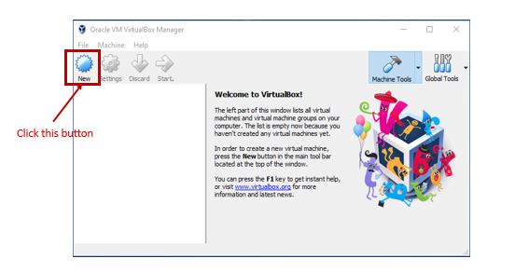
Import pre-built Ubuntu 16.04 VM image
Step 1: Create a New VM in VirtualBox
6
Notes:
6
Start virtualbox. In the toolbar, click the New button.
Please refer to the document for the detailed installation and configuration via the link provided
https://seedsecuritylabs.org/Labs_16.04/Documents/SEEDVM_VirtualBoxManual.pdf
For your convenience, this important document has been provided on the CourseLink course website.

Slide 7
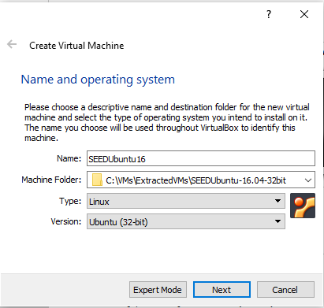
Import pre-built Ubuntu 16.04 VM image (cont’d)
Step 2: Provide a Name and Select the OS Type and Version
Pick any name you like
VM folder
Choose Linux Ubuntu (32-bit)
7
Notes:
7
Provide a Name for the virtual machine in the Name field,
Select the VM folder by navigating to the folder of the extracted VM
and then Select the OS Type (Linux) and Version ( Ubuntu (32-bit)).
Please note that Do NOT pick Ubuntu (64-bit), even though most likely your machine is 64 bit. The prebuilt VM is 32-bit Ubuntu.

Slide 8
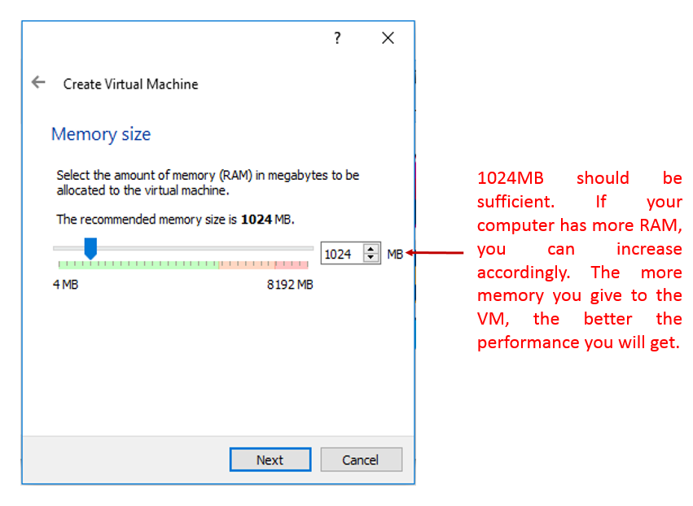
Import pre-built Ubuntu 16.04 VM image (cont’d)
Step 3: Set the Memory Size
8
Notes:
8
Set the Memory Size. 1024 MB should be sufficient, but we recommend 2GB. If your computer has more
RAM, you can increase accordingly. The more memory you give to the VM, the better the performance you will get.

Slide 9
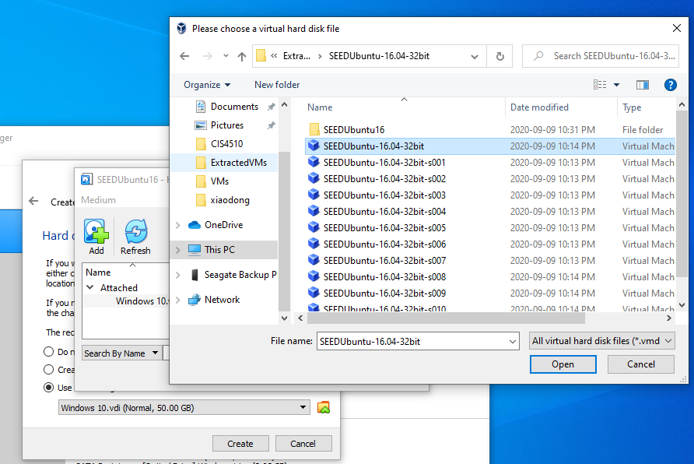
Import pre-built Ubuntu 16.04 VM image (cont’d)
Step 4: Select the Pre-built VM File Provided in downloaded images
Step 3: Select SeedUbuntu 16.04 virtual hard disk file
Step 2: Add Disk Image
Step 1: Choose a virtual hard disk file
9
Notes:
9
Click Choose a virtual hard disk file ... button
Then, Click Add Disk Image and select the virtual hard disk file (or VMDK) by navigating to the folder of the extracted VM

Slide 10
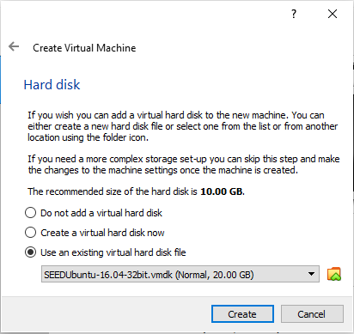
Import pre-built Ubuntu 16.04 VM image (cont’d)
Step 5: Select the Pre-built VM File Provided in downloaded images
Now you can select SeedUbuntu 16.04 virtual hard disk file
10
Notes:
10
Now you can select SeedUbuntu 16.04 virtual hard disk file
And click Create Button

Slide 11

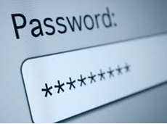
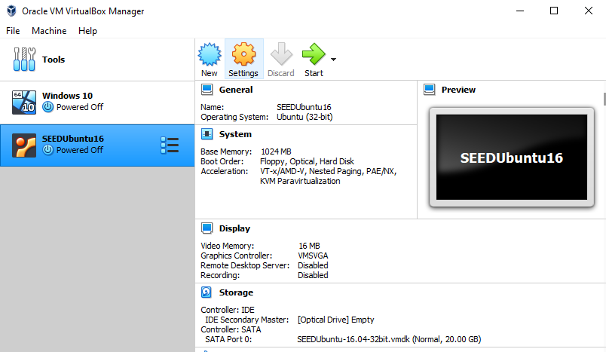
Imported Pre-built Ubuntu 16.04 Virtual Machine
seed
dees
root
seedubuntu
Successfully created
11
Notes:
Afterwards, the VM should be created successfully if everything goes well
The pre-built Ubuntu 16.04 VM comes with two accounts:
username: seed
password: dees
This is a regular user account that you can use for most of your Lab assignments.
username: root
password: seedubuntu

Slide 12
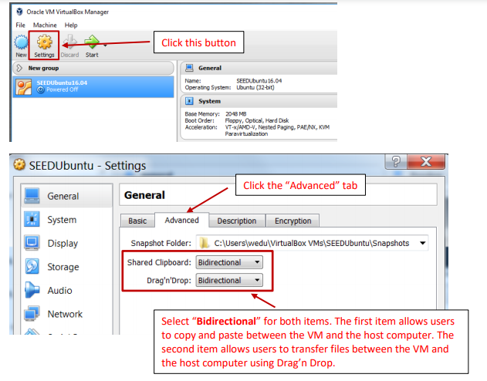
Configure the VM
12
Notes:
12
Next, we need to do some configuration to make us easy to use the VM.
In the toolbar, click Settings button and click the “Advanced” tab
Select “Bidirectional” for both items. The first item allows users to copy and paste between the VM and the host computer.
The second item allows users to transfer files between the VM and the host computer using Drag’n Drop.

Slide 13
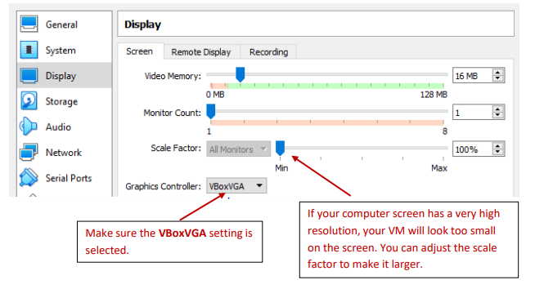
Configure the VM (cont’d)
13
Notes:
13
Next, Go to Display, select VBoxVGA as your Graphics Controller. If your computer screen has a very high resolution, your VM will look too small on the screen. You can adjust the scale factor to make it larger.

Slide 14
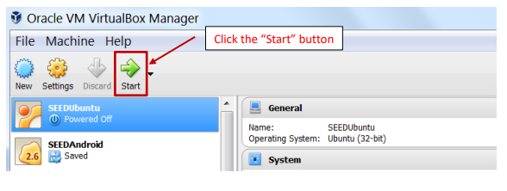
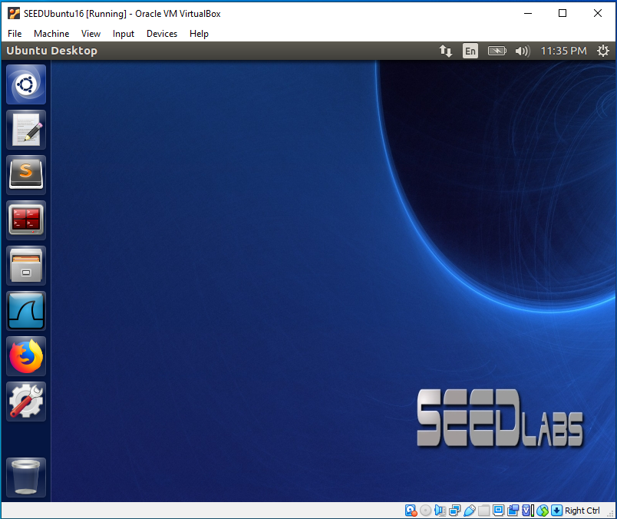
Start VM
14
Notes:
Now you can start VM. If your installation goes smoothly, you should see you are automatically logged into the VM as the user “seed”.

Slide 15
VirtualBox Network Configuration
Internet
Your Computer
or
Pre-configured Ubuntu 16.04 Virtual Machines
15
Notes:
Next, let’s configure our virtualbox network properly so
all the VMs can communicate to each other, and are connected to the Internet.

Slide 16
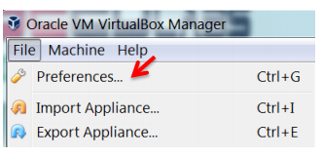
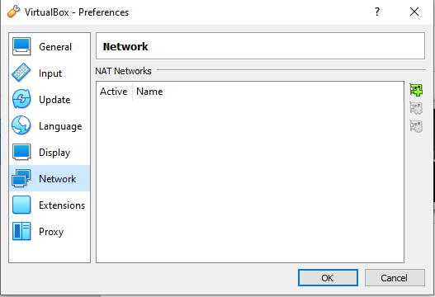
VirtualBox Network Configuration (cont’d)
Step 1: Click the File->Preferences…
16
Notes:
16
Make sure your VM is powered off when you configure it.
VirtualBox has many networking types. In order to achieve our goals, we will use "NAT Network".
Click the “File” on the top left of the VirtualBox main UI. Then choose “Preferences…” option.

Slide 17
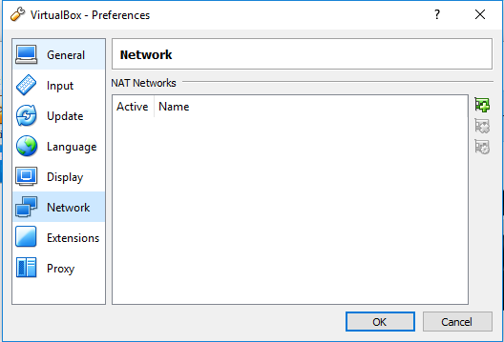
VirtualBox Network Configuration (cont’d)
Step 2: On VirtualBox - Preferences dialog box, click the “Network” tab on left panel
17
Notes:
17
On VirtualBox - Preferences dialog box, click the “Network” tab on left panel

Slide 18
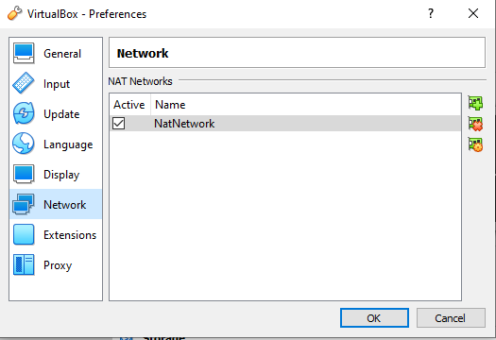
VirtualBox Network Configuration (cont’d)
Step 3: In the Figure below, click the “+” button to create new NAT Networks (NatNetwork).
Adds new NAT Network
18
Notes:
18
In the Figure below, click the “+” button to create new NAT Networks (NatNetwork).

Slide 19
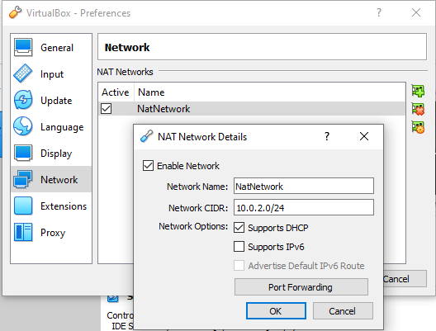
VirtualBox Network Configuration (cont’d)
Step 4: Double click on the NatNetwork added in the previous slide, and look at its specifications. Set the specifications as same as the following Figure.
Newly added NAT Network
"NAT Network" Specifications
19
Notes:
19
Double click on the NatNetwork added in the previous slide, and look at its specifications. Set the specifications as same as the Figure shown here.

Slide 20
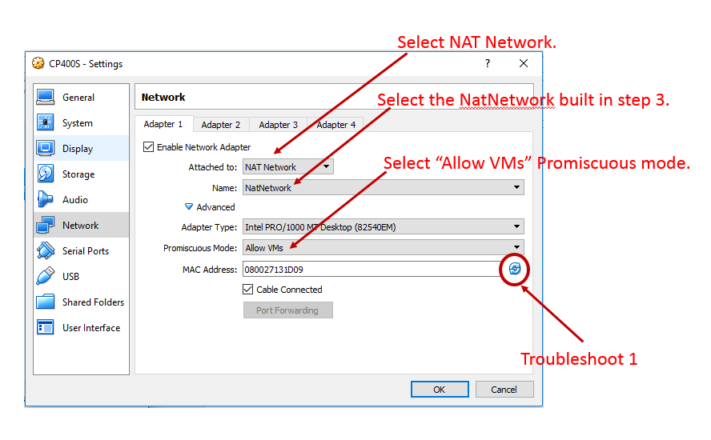
VirtualBox Network Configuration (cont’d)
Step 5: Go to VM setting, you need to power off the VM before making the following changes. In the following Figure, enable Adapter 1 (at the same time, disable the other adapters), and choose “NAT Network”.
20
Notes:
20
Finally, Go to VM setting, you need to power off the VM before making the following changes. In the Figure here, enable Adapter 1 (at the same time, disable the other adapters (By default, the other adapters should already be disabled.)), and choose “NAT Network”.

Slide 21
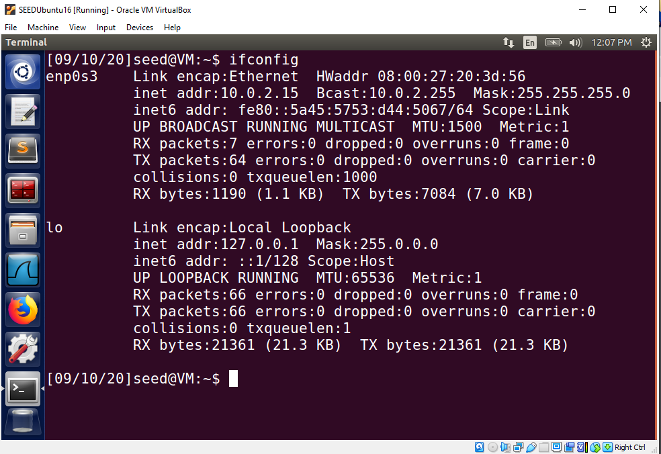
VirtualBox Network Configuration (cont’d)
Step 6: Now power on the VM, and check IP address (your IP may vary from the one shown in the following figure).
21
Notes:
21
Now you can power on the VM, and check IP address. Please note that your IP may vary from the one shown in the following figure.

Slide 22
Folder Sharing
Internet
Your Computer
or
Pre-configured Ubuntu 16.04 Virtual Machines
22
Notes:
It’s highly recommended to create a shared folder between host computer and guest operating system (or your newly installed VMs). Next, let’s configure our VM to make it happen.

Slide 23
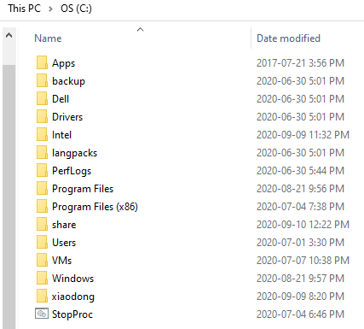
Folder Sharing
Step 1: Create the shared folder named “share” on hos computer
Shared folder on host computer
23
Notes:
23
First, create the shared folder named “share” on hos computer. Please note that you can pick up any name that you like.

Slide 24
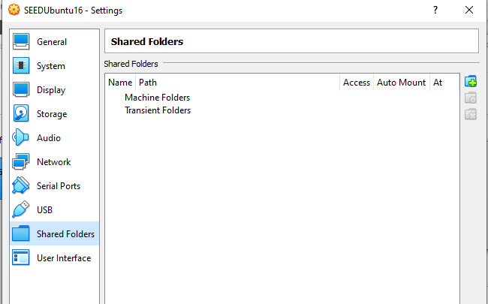
Folder Sharing (cont’d)
Step 2: Boot the Guest operating system (VM) in VirtualBox
Go to the Settings popup window, and select "Shared Folders"
24
Notes:
24
Start your VM in VirtualBox
Go to the Settings popup window, and select "Shared Folders"

Slide 25
Folder Sharing (cont’d)
Step 3: Click the 'Add' button
Add a new shared folder
25
Notes:
25
Click the 'Add' button

Slide 26
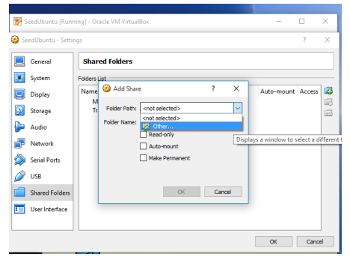
Folder Sharing (cont’d)
Step 4: Choose “Other …”, and select a folder from the popup window. The folder is the one you have created on your host computer
26
Notes:
26
Choose “Other …”, and select a folder from the popup window. The folder is the one you have created on your host computer

Slide 27
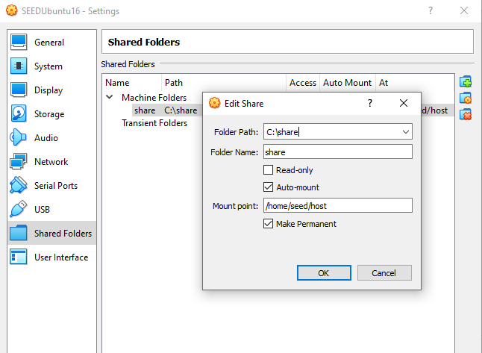
Folder Sharing (cont’d)
Step 5: Select Auto Mount and Make Permanent option, and enter “/home/seed/host” into the Mount point field.
Click OK. Click OK again to close the Settings Dialog.
27
Notes:
27
Select Auto Mount and Make Permanent option, and enter “/home/seed/host” into the Mount point field. Click OK. Click OK again to close the Settings Dialog

Slide 28
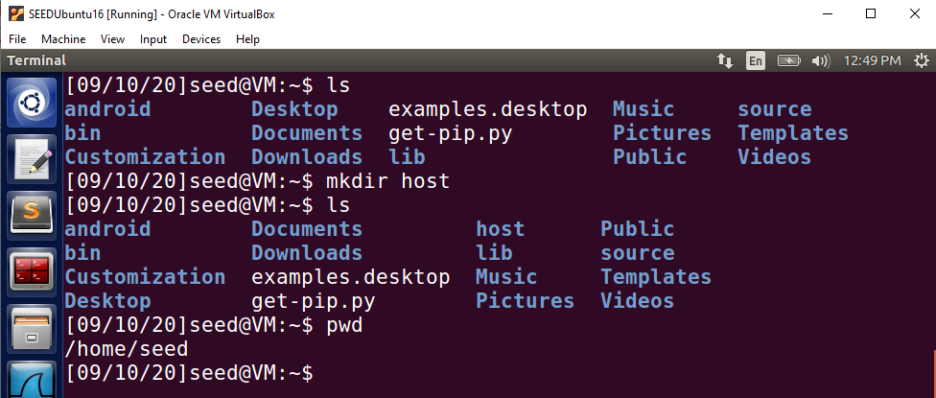
Folder Sharing (cont’d)
Step 6: Open a terminal in the VM. Make a folder and name it host. Use command "mkdir /home/seed/host"
Shared folder on VM
28
Notes:
28
Open a terminal in the VM. Make a folder and name it host. Use command "mkdir /home/seed/host"

Slide 29
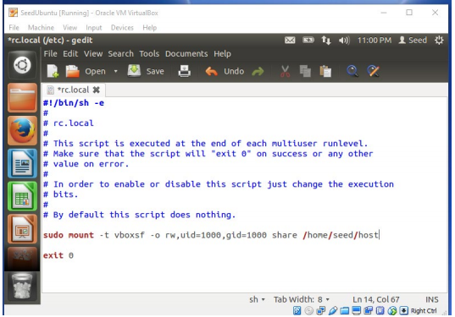
Folder Sharing (cont’d)
Step 7: We want files in our mount point (~/host) to be owned by the current user. Also we want the mounted shared folder to persist after reboot. Hence, we will edit the /etc/rc.local file (using “sudo gedit /etc/rc.local”). Open a terminal in the VM, type
sudo gedit /etc/rc.local
, and add the command below (1000 is the User ID and group ID of the user seed):
sudo mount -t vboxsf -o rw,uid=1000,gid=1000 share /home/seed/host
29
Notes:
29
We want files in our mount point (~/host) to be owned by the current user. Also we want the mounted shared folder to persist after reboot. Hence, we will edit the /etc/rc.local file (using “sudo gedit /etc/rc.local”). Open a terminal in the VM, type
sudo gedit /etc/rc.local
, and add the command below (1000 is the User ID and group ID of the user seed):
sudo mount -t vboxsf -o rw,uid=1000,gid=1000 share /home/seed/host

Slide 30
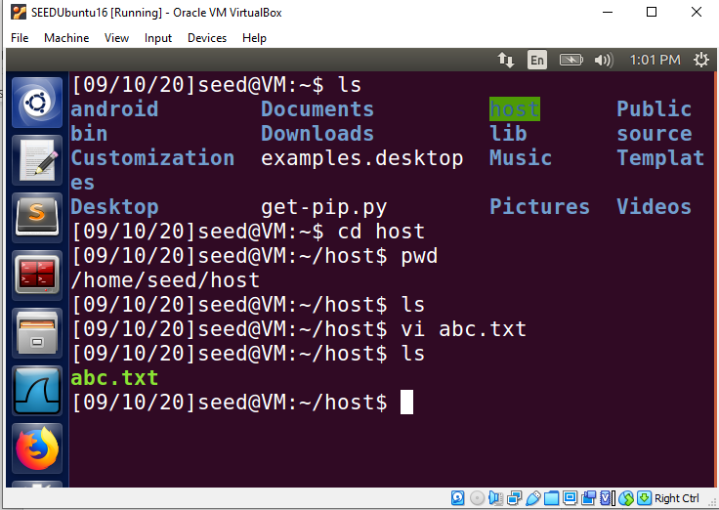
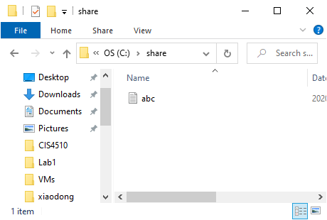
Folder Sharing (cont’d)
Step 8: Save the changes and reboot VM. Now anything placed in /home/seed/host inside the VM should be visible from the share folder on the host machine, and vice versa.
VM
Host computer
30
Notes:
30
Save the changes and reboot VM. Now anything placed in /home/seed/host inside the VM should be visible from the share folder on the host machine, and vice versa.
For example, I created a file named abc.txt in VM, which is accessible on host computer as well.

Slide 31
Setup multiple guest VMs
Internet
Your Computer
or
Pre-configured Ubuntu 16.04 Virtual Machines
31
Notes:
In this class, some labs require multiple VMs. use “Clone” to create Multiple VMs.
Before doing the cloning, please make sure that the VM is fully shutdown (not even in a “Saved” state).
Next, we Some SEED labs require multiple VMs.

Slide 32

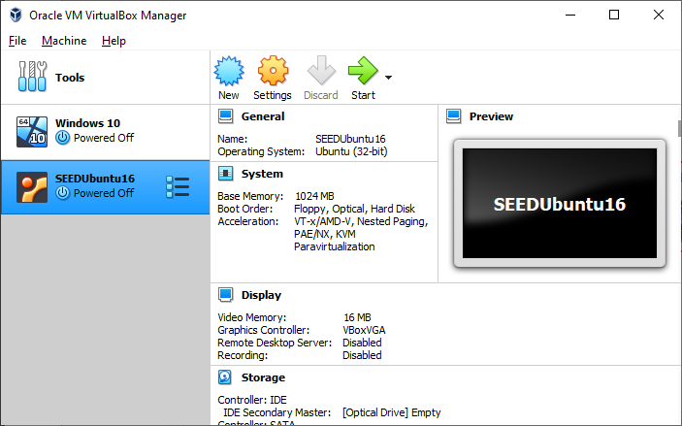
The VM must be fully shutdown!
32
Notes:
Please power off your VM before doing the cloning.

Slide 33
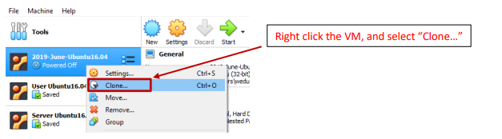
Setup multiple guest VMs
Step 1: Right click the VM, and select “Clone…”
33
Notes:
33
Right click the VM, and select “Clone…”

Slide 34
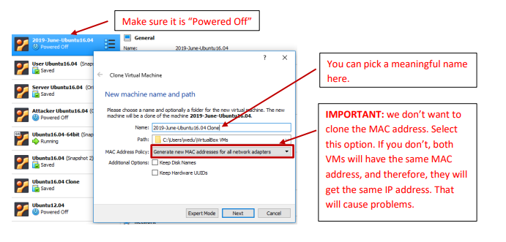
Setup multiple guest VMs (cont’d)
Step 2: Clone the VM
34
Notes:
34
Then Clone the VM. You can pick a meaningful name for your new cloned VM. Also, we don’t want to clone the MAC address. Instead, Select the option to generate a new MAC address.

Slide 35
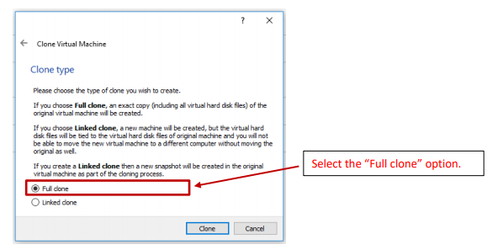
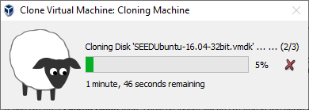
Setup multiple guest VMs (cont’d)
Step 3: Do the full clone.
35
Notes:
35
Do the full clone. The clone will take a few minutes, depending on the speed of your computer.
You can repeat the same procedure to clone another one.

Slide 36
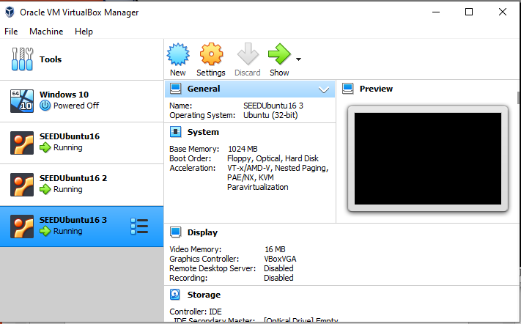
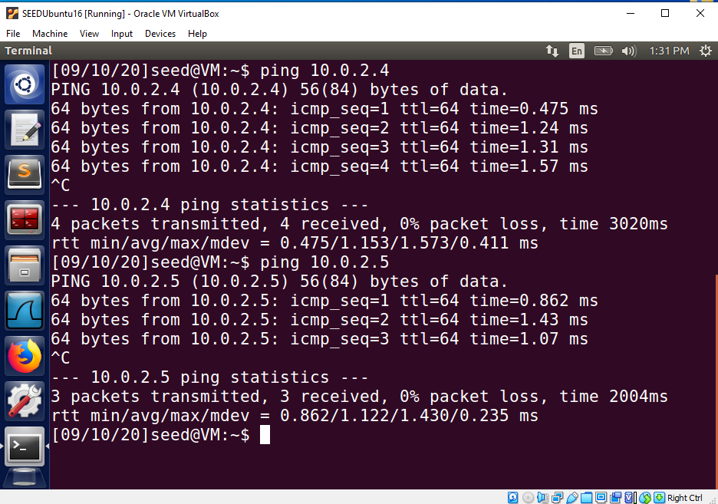
36
Notes:
Finally, you shout have three VMs ready for you. If you open a terminal in one VM and ping other two VMs, you should see responses back. Also, you should be able to go to the Internet from your VMs.

Slide 37
Congratulations! Your Cybersecurity Lab is now ready to go.
37
Notes:
Congratulations! Your Cybersecurity Lab is now ready to go.

Slide 38

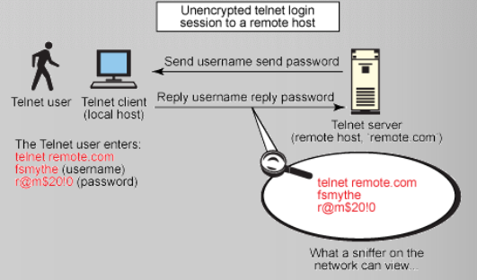
38
Notes:
Next, you will practice some computer network skills to test a little computer and network security. Recall a popular network protocol called Telnet, which is used to virtually access a computer and to provide a two-way, collaborative and text-based communication channel between two machines.
How does it work? It is very simple. If a user wants to connect to a server by using the Telnet protocol.
The user types Telnet into a command prompt by following this syntax: telnet servernameoripaddress.
The user will be authenticated by providing the username and password.
The user can then execute commands on the server by typing the commands into the Telnet prompt.

Slide 39
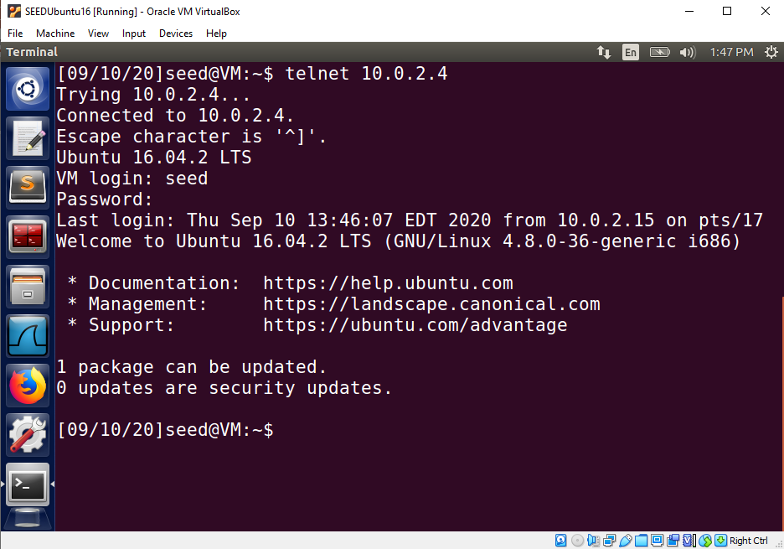
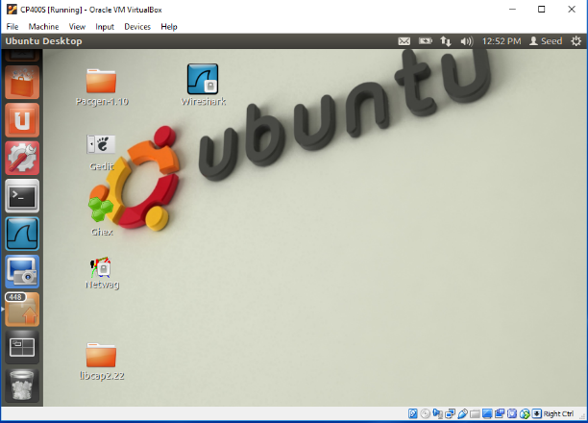
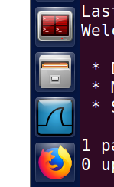

VM 1
VM 2
1
telnet <VM2 ip address>
Terminal
2
Wireshark
Capture Telnet traffic and discover password
39
Notes:
So you can practice the Telnet and also use Wireshark to capture Telnet traffic. Afterwards, you will need to answer some questions required in the lab.

Slide 40

Discussion
This lab shows how easily a telnet session can be casually viewed by anyone on the network using a network-sniffing application such as Wireshark. In other words, if we use Telnet to gain access to a remote machine, it is not secure. Nowadays, SSH is widely used for remotely accessing another host over the network.
Can you sniff SSH traffic and discover the username and password?
40
Notes:
This lab shows how easily a telnet session can be casually viewed by anyone on the network using a network-sniffing application such as Wireshark. In other words, if we use Telnet to gain access to a remote machine, it is not secure. Nowadays, SSH is widely used for remotely accessing another host over the network.
So next you will use ssh to remotely access another VM and then use Wireshark to capture SSH traffic as well. Afterwards, you will need to answer some questions required in the lab.

